Slide 1



Bruce Rapkin, PhD
Rita Ravichandar, MSW
Rev. Zorina Costello,DMin
Ivis Sampayo
David Lounsbury, PhD
Lauren Jones, MPH
Parisa Tehranifar, PhD
Nancy Sohler, PhD
Andria Reyes, MSW
Nina Bickell, MD, MPH
Karen Hubbard, PhD
Mary Beth Terry, PhD
Desiree Walker
Diversity and Equity in Scientific Research Underpinning Prevention and Therapeutic Trials
Notes:
Karen

Slide 2
Aim 1: Disrupt community norms about Clinical Trials by formulating & sharing a new discussion about cancer research & care
Notes:
Bruce

Slide 3
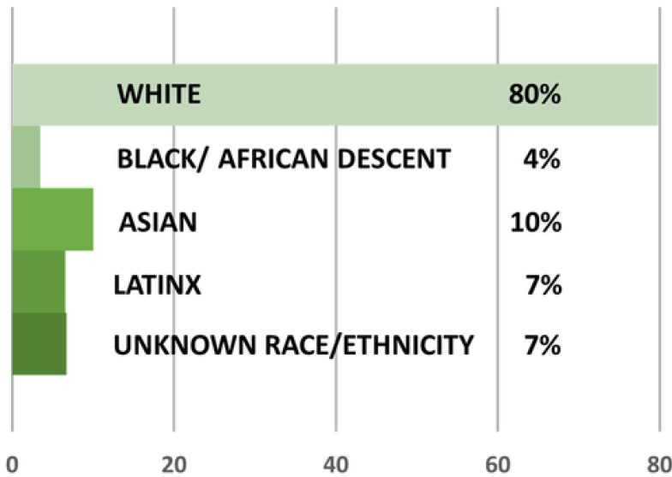
Why do we need to DISRUPT the Cancer Clinical Trials System?
Racial/Ethnic Representation on Clinical Trials that led to FDA Approval of New Cancer Drugs in 2021-22
Low rates of accrual to cancer clinical trials
6%-7% accrual at community hospitals
14%-16% accrual at academic hospitals
Black,indigeneous and other minoritized groups constitute only 20% of therapeutic trials but more than 40% of the population
Although these disparities have been recognized for decades, progress has been slow
Our goal is to disrupt community, clinical and scientific norms to improve diversity in cancer clinical trials. We want to make sure that new treatments are equally effective for ALL patients.

Slide 4
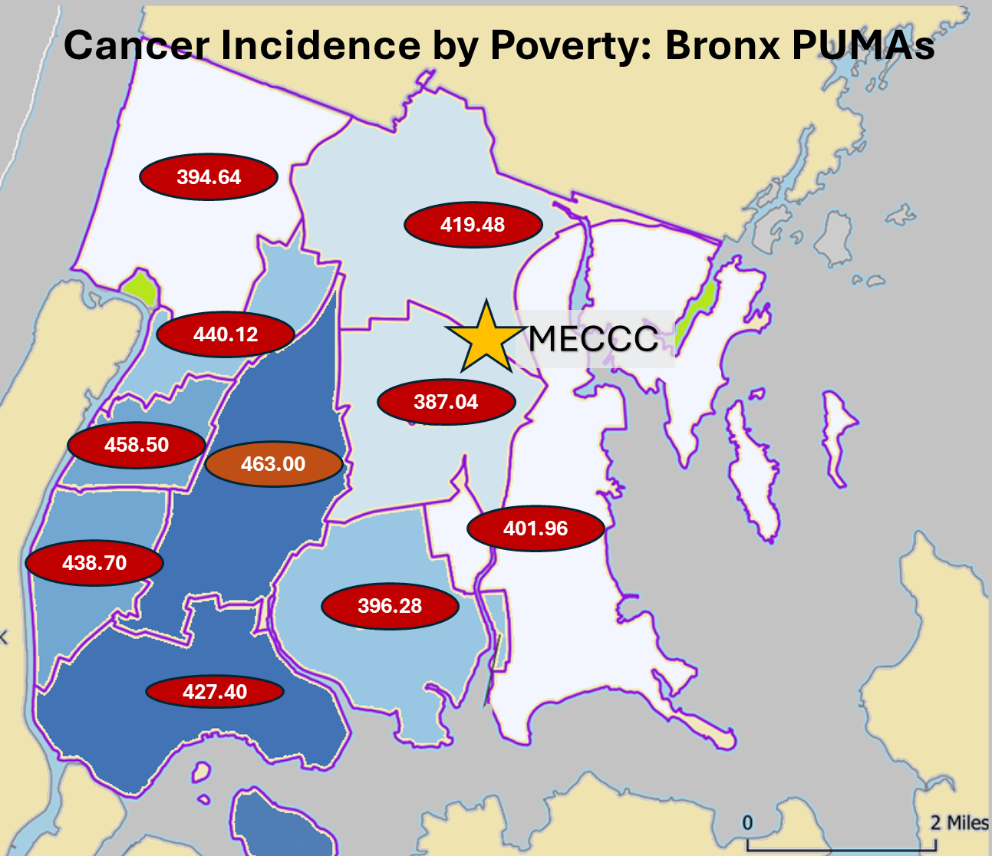
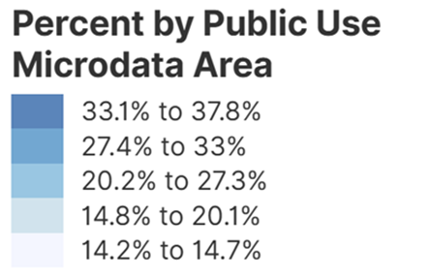
MECCC’s Catchment Area: Bronx County NYC
85% of MECC patients come from the Bronx
1.4v million residents
• 48% Hispanic/LatinX
• 36% non-Hispanic Black or African American
• 5% Asian
32% Immigrant:
60% speak language other than English at home
Among poorest U.S. urban counties:
• 30% live in poverty
Correlation of cancer incidence with poverty: rho = .83 at the neighborhood level
Source: SEER 2018-2022; US Census 2025

Slide 5
Excess Cancer Burden in the Bronx
Absolute Rates in the BronxV
Highest Incidence |  |  | Highest Mortality |  |  | Highest MIR
All_Sites | 415.4 |  | All_Sites | 243.4 |  | All_Sites | 0.59
Prostate | 148 |  | Prostate | 101.8 |  | Male Breast | 0.90
Female Breast | 113.8 |  | Female Breast | 44.8 |  | Liver_Intrahepatic_Bile_Duct | 0.88
Lung_Bronchus | 40.9 |  | Lung_Bronchus | 28.9 |  | Esophagus | 0.84
Corpus_Uterus_NOS | 31.6 |  | Colon_excluding_Rectum | 17.1 |  | Larynx | 0.81
Colon_excluding_Rectum | 24.3 |  | Corpus_Uterus_NOS | 16.8 |  | Mesothelioma | 0.75
Non_Hodgkin_Lymphoma | 18.1 |  | Liver_Intrahepatic_Bile_Duct | 10.6 |  | Brain_Other_Nervous_System | 0.72
Bronx burden compared to NYS (without NYC)
Highest Relative Incidence |  |  | Highest Relative Mortality |  |  | Highest Relative MIR
All_Sites | 0.832 |  | All_Sites | 0.923 |  | All_Sites | 1.109
Kaposi_Sarcoma | 6.500 |  | Kaposi_Sarcoma | 8.000 |  | Melanoma_of_the_Skin | 1.765
Liver_Intrahepatic_Bile_Duct | 1.635 |  | Liver_Intrahepatic_Bile_Duct | 1.963 |  | Skin_excluding_Basal_Squamous | 1.745
Cervix_Uteri | 1.453 |  | Cervix_Uteri | 1.714 |  | Hodgkin_Lymphoma | 1.500
Myeloma | 1.413 |  | Myeloma | 1.556 |  | Testis | 1.494
Stomach | 1.356 |  | Hodgkin_Lymphoma | 1.500 |  | Male Breast | 1.400
Anus_Anal_Canal_Anorectum | 1.273 |  | Stomach | 1.395 |  | Kidney_Renal_Pelvis | 1.266

Slide 6
Health equity depends upon representation in medical research,
Starting to discuss research when a trial is needed is too late!
Beliefs about research are shaped throughout life by cultural and community norms
To earn trust, research must be visible, accessible and accountable
There are many opportunities to talk about health and research
Stakeholders are needed to reach different settings and guide dialogue
Why is it important to start a new dialogue about cancer care and medical research with communities?

Slide 7
Traditional design involves designers working independently, making decisions based on their expertise, user research and best practices. Users might be involved through research or testing but are not usually part of the creative process or decision-making. Co-design is a collaborative approach where designers work together with non-designers to create solutions. Designers act as facilitators and guide the participants through the design process.
Co-Design: Harnessing collective wisdom
to innovate and solve problems effectively
Interaction Design Foundation - IxDF. (2023, December 29). What is Codesign?. Interaction Design Foundation - IxDF. https://www.interaction-design.org/literature/topics/codesign

Slide 8
Different types of organizations can play a part in fostering discussion about cancer clinical trials in the broader community
Support Organizations,
Faith-Based Organizations
Primary Care Clinics
Schools
Arts and Cultural Organizations
Neighborhood and Housing Associations
Community Centers

Slide 9
DISRUPT Approach to Community Engagement
Phase 0: Advocates with academics in leadership positions on this project.
Phase 1: Feedback through community engagement studios.
Phase 2: CBPR Action Committees focused on: Engagement, Education, Evaluation.
Phase 3: Outreach workshops with 50+ Community-Based Organizations.
Phase 4: Organizations join DISRUPT as Co-Design, Networking, or Information Partners.
Phase 5. Dissemination of co-designed messages: schools, faith, clinics, cultural, housing, human services
Notes:
As you know, the goal of Aim1 is to DISRUPT misinformation andnegative attitudes about clinical trials by encouraging new conversations in communities, focused on the importance of representation in research to achieve health equity.
Our work has progressed through these phases, culminating in the dissemination of co-designed strategies in Phase 5.

Slide 10
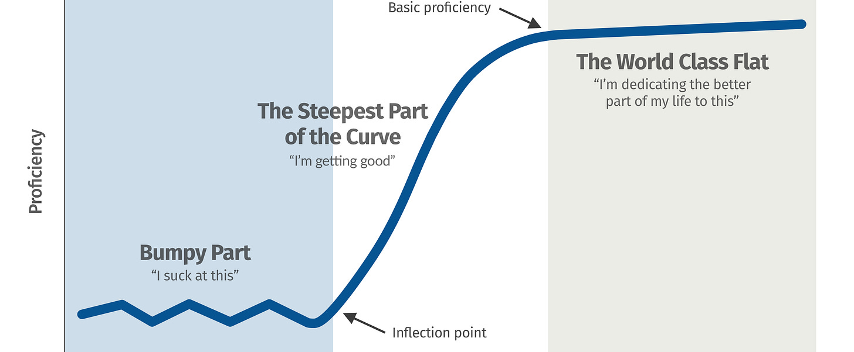
The DISRUPT Co-Design Learning Curve
Implementation Challenges
Evaluation and Improvement
Phase 4
Phase 5
Bi-Directional Learning
Contracting and Budget
Phase 3
Cohesion and Support
/
Talking Points
Phase 1
Phase 2
Outreach Opportunities
Identity and Trust
Cancer Content
Finding your voice
Notes:
Throughout the study phases, our research teams has been on a three-year learning curve with our community champions. After identifying our partners through community studios in Phase 1, our group developed trusts, identified audiences, framed messages, and figured out logistics. We are nowinvolved in meeting implementation challenhges as we disseminated this work.

Slide 11
Insights from Co-Designers that Have Strengthened DISRUPT’s Outreach
Research is a source of hope, but there is also fear, uncertainty and mistrust.
Will I just be a guinea pigs?
Would my family member have survived if we had known about trials?
Why doesn’t research include people like us?
What have the researchers found out about our community?
Community program participants’ cultural and social concerns about cancer research are intertwined with their own family histories and lived experiences.
People may be distressed and even traumatized by cancer. Raising this topic has required us to make spiritual and mental health resources available,
DISRUPT programs often provide time for participants to share their stories about the impact of cancer and research on themselves and their families
Co-designed projects can empower participants through knowledge, shared experiences, collective action, and spiritual connection

Slide 12

DISRUPT Aim1 Activities and Reach
Conducted 111 outreach activities with 82 different organizations and venues
Presentations and panels were conducted at 27 venues with 21 community partners
Tabling at 64 community health fairs
Networking at 14 local and national meetings
Over 12,157 people have been exposed to DISRUPT at community events
Partnered with Community Outreach and Engagement activities at all three cancer centers to expand and sustain our reach
Created roles and supported the work of 12 undergraduate and post-bac students from Manhattan and the Bronx as Aim 3 Student Ambassadors
Now screening – the DISRUPT ACTION Committee Video on “Disrupting Cancer: Compassion, Community, Science and Hope”
Notes:
Our activities in the community continue, as these highlighted numbers show. We estimate that we have reached over 12,000 people at 27 codesigned events and 64 health fairs. This past fall, we also began screenings of our video, “Disrupting Cancer: Compassion, Community, Science and Hope” to community audiences.

Slide 13
Phase 4: DISRUPT Action Committee Members’ Co-Designed Projects
Adaptation of DISRUPT for Japanese and other linguistic minorities
Engagement of Small Business Leaders in the Latinx Community
Dominican Writers’ Association Anthology Project
Abyssinian Baptist Church Health Ministry Projects
CRAVE Theater Workshops and Performances at Senior Centers
Pediatric (Ronald McDonald) and Adult (Bronx VA) Cancer Patient Engagement
Outreach on HIV and Cervical Cancer

Slide 14
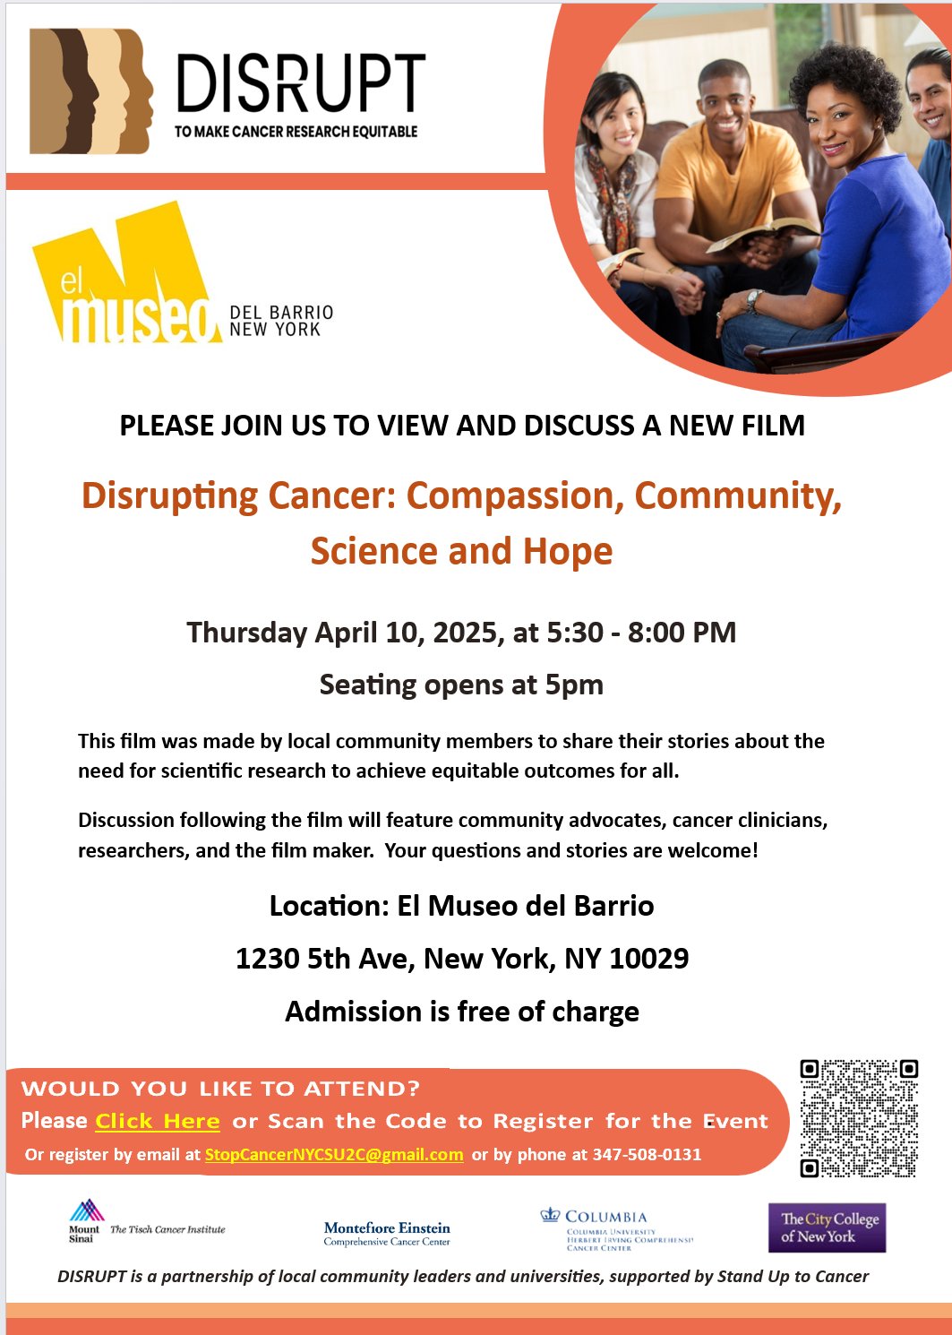
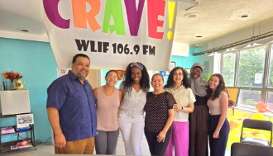
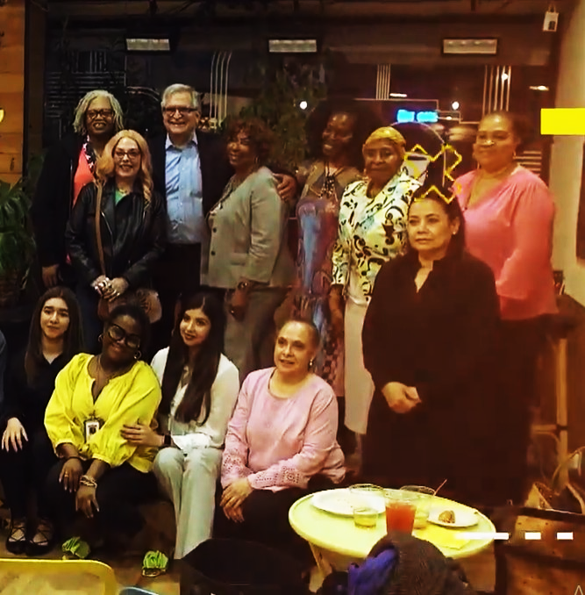

Slide 15

Characteristics of Evaluation Sample (as of 12/17/2024)
 | Pre-Event | Post-Event | Tabling | Total Sample
COVARIATES | N=55 | N=103 | N=50 | N=208
Mean Age | 67y | 50y | 55y | 56y
Sex-Male | 13% | 43% | 29% | 32%
African American/Black | 80% | 33% | 32% | 45%
Latinx/Hispanic | 2% | 31% | 38% | 25%
Born in the US | 96% | 77% | 88% | 85%
College Graduate | 65% | 57% | 55% | 59%
Full-Time Employed | 36% | 25% | 40% | 31%
Unemployed | 48% | 46% | 48% | 47%
Self-Employed | 9% | 32% | 10% | 21%
Notes:
Our evaluation of our programs’ impact uses on-line surveys. Survey participants have been recruited in numerous different sentings, completing surbeys prior to events DISRUPT programs, some time after participating a program, or at community health fair tables and similar venues.
This provides a very informative quasi-experimental design to determine the impact of DISRUPT by allowing us to consider differences in intention to participate and in actual exposure to messaging.
As this table shows, the three groups differed on a number of characteristics, such as age, sex, race/ethnicity, education and employment. These variables were controlled prior to testing for group differences related to DISRUPT.

Slide 16
Starting a New Dialogue about Research – DISRUPT Attendees vs. Non-Attendees
How often did you speak with family or friends… | Correlation
who had trouble finding health information about health concerns? | 0.196 | *
about injustice and racism in healthcare? | 0.286 | **
about the reasons why it is important for people to take part in medical research? | 0.262 | **
about a positive experience with healthcare? | 0.172
N = 89
*p <.10
**p <.05

Slide 17
Impact on Behavior: Differences in Talking about the Importance of Research vs. Racial Injustice in Medicine
Significance of Difference: F(2,154)=3.29, p<.04
Notes:
Interestingly, our analysis also showed that the Pre-DISRUPT group reported having more frequent conversations about racial injustice in the health care system. This was not evident in the post-Event group. This might be take to suggest that DISRUPT programs changed these conversations as well.
To examine this, we looked at group differences in the relative frequency of talking about the importance of research versus discussion of racial injustice. In the pre-event group, discussion of racial injustice was significantly more frequent than discussions about he importance of research. This difference was also evident in the Tabling group, although discussions of both topics were less frequent. In the post-event group, frequency of the two types of conversations were equal.
This finding is consistent with the goal of starting a new conversation in communities. Although discussion of the negative history about research and health care is not suppressed, it is balanced by an emphasis on the reasons why representation in research matters.

Slide 18
Opportunities for Dissemination
of Co-Designed Strategies
Sustaining Individual Projects
Integrating Lessons Learned at Cancer Centers
Disseminating to New Communities and Settings
Adapting and Extending to Other Challenges

Slide 19
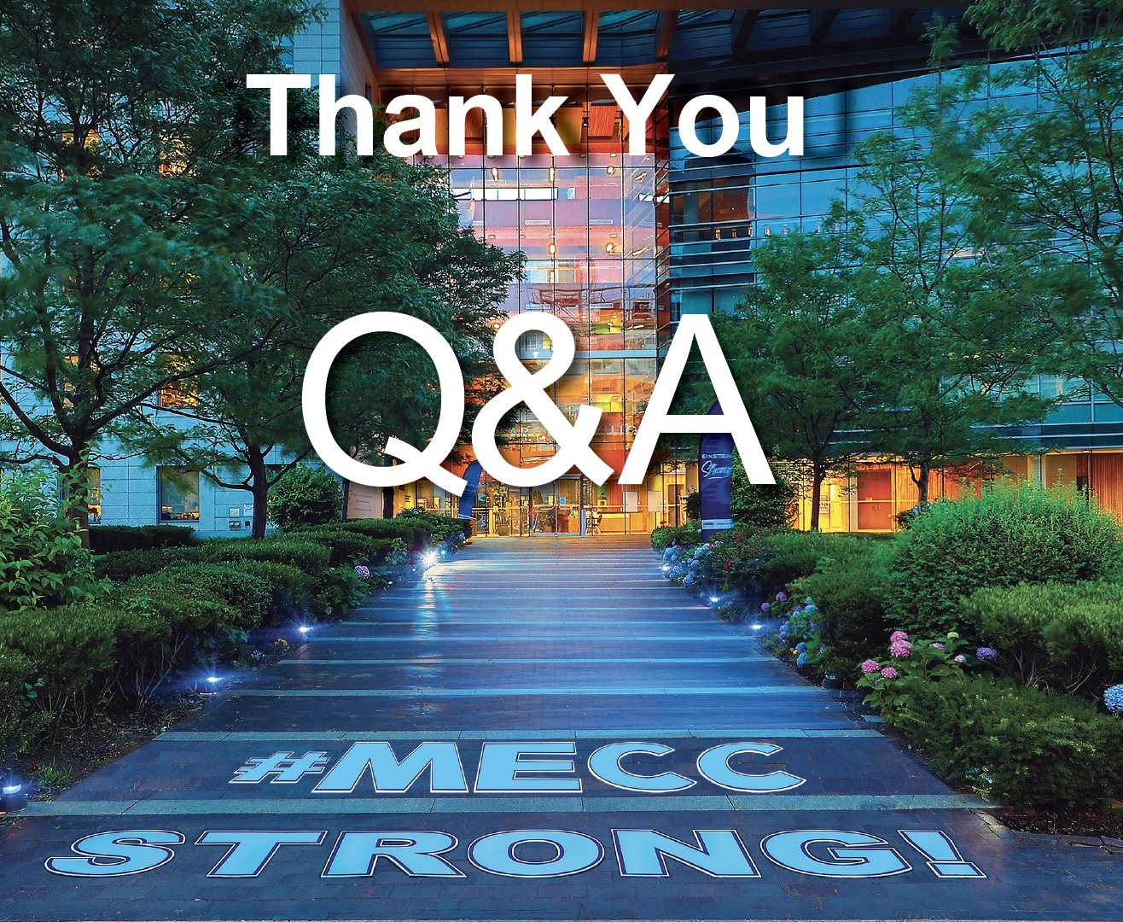
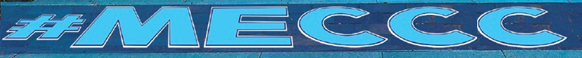
Gracias
감사합니다
Grazie
شكرًا لك
Merci
ありがとうござ
ました
Danke
A dupe
谢谢
Da ase
תודה
Obrigado
Dziękuję
Faleminderit
ধন্যবাদ
Mèsi an
Cảm ơn bạn
ευχαριστώ
多謝
спасибо
Salamat
дякую
Daalụ
धन्यवाद
Notes:
Get better resolution.

